Slide 1
Algebraic Numbers
R T

Slide 2
Introduction to algrebraic number theory
A History of Numbers
Algebraic Numbers
Zero & Negatives
Complex Numbers
Pi
Golden Ratio
Binary & Bases
Primes & RSA
An algebraic number is a complex number that is the root of a polynomial equation with integer coefficients.
Example - $\sqrt{2 }$ is an algebraic number because it is the root of the equation $x^{2}+2=0$.
Important Mathematicians in this field:
Diophantus
Fermat
Gauss
Dirichlet
Dedekind
Hilbert
Artin
Wiles

Slide 3
Early instances of Algebraic Numbers
A History of Numbers
Algebraic Numbers
Zero & Negatives
Complex Numbers
Pi
Golden Ratio
Binary & Bases
Primes & RSA
Diophantus (201/215AD – 285/299AD, aged 84)
Typical Diophantine equation:
$$A=x+y$$
$$B=x^{2}+y^{2}$$

Slide 4
Fermat and his Last Theorem
A History of Numbers
Algebraic Numbers
Zero & Negatives
Complex Numbers
Pi
Golden Ratio
Binary & Bases
Primes & RSA
Pierre de Fermat (17th August 1601/1607 – 12th January 1665, aged 57/63)
Fermats last theorem
‘The Diophantine equation $x^{n}+ y^{n}= z^{n}$has no integer solutions for n > 2 and x, y, z ≠ 0’

Slide 5
Work on Algebraic number theory
A History of Numbers
Algebraic Numbers
Zero & Negatives
Complex Numbers
Pi
Golden Ratio
Binary & Bases
Primes & RSA
Friedrich Gauss (30th April 1777 – 23rd February 1855, aged 77)
Fundamental theorem of algebra - 1799
Julius Dedekind (6th October 1831 – 12th February 1916, aged 84)
Dedekind domains
Definition of a number field
Furth generalisation algraic number definition
Emil Artin (3rd March 1898 – 20th December 1962, aged 64)
Artin reciprocity law
Definition of Abelian extension

Slide 6
Proof of Fermats theorem and the modern theory
A History of Numbers
Algebraic Numbers
Zero & Negatives
Complex Numbers
Pi
Golden Ratio
Binary & Bases
Primes & RSA
Goro Shimura (born - 23rd February 1930)
Yutaka Taniyama (12th November 1927 – 17th November 1958. aged 31)
Modularity theorem
Andrew Wiles (born – 11th April 1953)
Proof of the modularity theorem for semi stable elliptic curves

Slide 7
Zero & Negatives
A S

Slide 8
Definitions
A History of Numbers
Algebraic Numbers
Zero & Negatives
Complex Numbers
Pi
Golden Ratio
Binary & Bases
Primes & RSA
Zero – The mathematical notation for the absence of a quantity.
Negative Numbers – The real numbers that are less than zero.

Slide 9
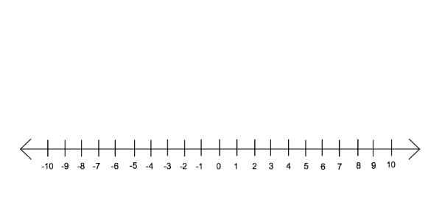
Placement on a Number Line
A History of Numbers
Algebraic Numbers
Zero & Negatives
Complex Numbers
Pi
Golden Ratio
Binary & Bases
Primes & RSA

Slide 10
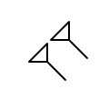
Timeline of Zero
A History of Numbers
Algebraic Numbers
Zero & Negatives
Complex Numbers
Pi
Golden Ratio
Binary & Bases
Primes & RSA
600-300BC – The Babylonians begin making use of a symbol that means ‘nothing in this column’. However the symbol is only used as a placeholder and has no value.

Slide 11
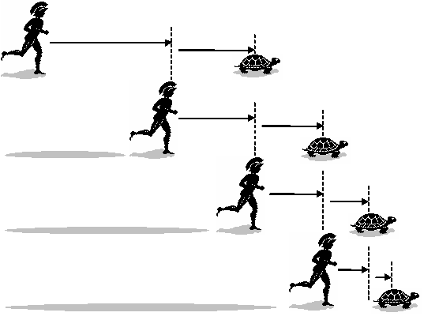
Timeline of Zero
A History of Numbers
Algebraic Numbers
Zero & Negatives
Complex Numbers
Pi
Golden Ratio
Binary & Bases
Primes & RSA
490BC – Birth of Zeno of Elea, creator of the famous Achilles paradox:

Slide 12
Timeline of Zero
A History of Numbers
Algebraic Numbers
Zero & Negatives
Complex Numbers
Pi
Golden Ratio
Binary & Bases
Primes & RSA
458 – The concept of zero first appears in India.
628 – Hindu astronomer and mathematician Brahmagupta develops a symbol for zero and mathematical operations using it. This is the first time in the world zero is recognised as a number.
1202 – Completion of the Liber abbaci, a medieval textbook that introduces the concept of zero and its sign to Western civilization. The book’s first chapter begins with the following two sentences: ‘These are the nine figures of the Indians: 9 8 7 6 5 4 3 2 1. With these nine figures, and with this sign 0 which in Arabic is called zephirum, any number can be written’.
1604 – First recorded usage of the word ‘zero’.

Slide 13
Timeline of Negative Numbers
A History of Numbers
Algebraic Numbers
Zero & Negatives
Complex Numbers
Pi
Golden Ratio
Binary & Bases
Primes & RSA
Unknown – The Ancient Chinese had a concept of negative numbers but no exact date or individual can be attributed to this. Negative numbers were represented using different coloured bamboo sticks; while red sticks were used for positive numbers, black sticks were used to indicate negative ones. The use of black and red ink in Western accounting may have originated from this Ancient Chinese practice, although the representations made by the colours have been switched.

Slide 14
Timeline of Negative Numbers
A History of Numbers
Algebraic Numbers
Zero & Negatives
Complex Numbers
Pi
Golden Ratio
Binary & Bases
Primes & RSA
628 – Brahmagupta’s most famous book, Brahma Sphuta Siddhānta, is written. It contains several chapters on mathematics and in those chapters rules for addition, subtraction, multiplication and division using negative numbers are created.
1114-1185 – Lifetime of Hindu mathematician Bhāskara. He can be credited with increasing acceptance of negative numbers among the mathematical community by treating them as debts or losses and therefore finding a common application for them.

Slide 15
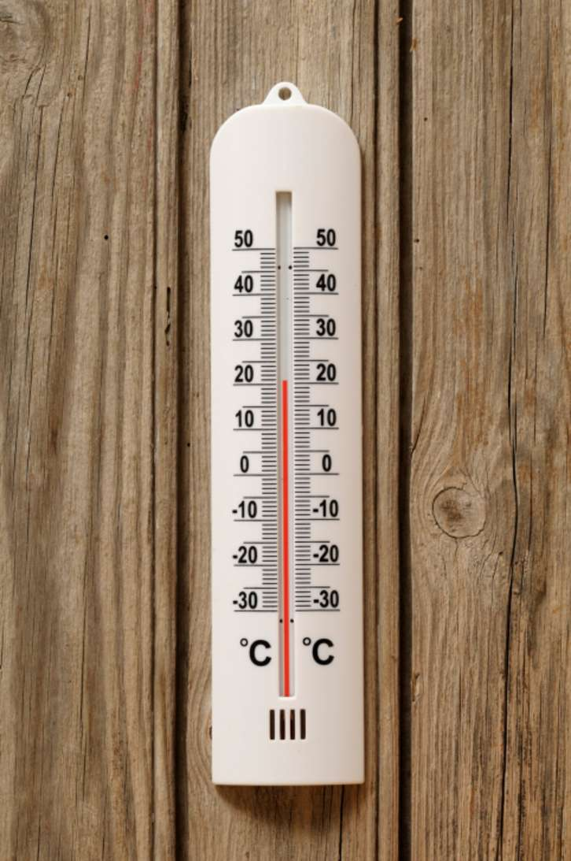
Timeline of Negative Numbers
A History of Numbers
Algebraic Numbers
Zero & Negatives
Complex Numbers
Pi
Golden Ratio
Binary & Bases
Primes & RSA
1741 – Creation of what is now known as the ‘degrees Celsius’ temperature scale:

Slide 16
Complex Numbers
R S

Slide 17
What is a Complex Number?
A History of Numbers
Algebraic Numbers
Zero & Negatives
Complex Numbers
Pi
Golden Ratio
Binary & Bases
Primes & RSA
$a$ = The real part
$b$ = The imaginary part
$$a+bi$$
$i$ = Imaginary number, $\sqrt{−1}$

Slide 18
Cardano (1501-1576) – The Irreducible case
A History of Numbers
Algebraic Numbers
Zero & Negatives
Complex Numbers
Pi
Golden Ratio
Binary & Bases
Primes & RSA
Depressed cubic equation:
$$x^{3}+px=q$$
$$x=u+v=\sqrt[3]{\frac{q}{2}+\sqrt{\frac{q^{2}}{4}+\frac{p^{3}}{27}}}−\sqrt[3]{−\frac{q}{2}+\sqrt{\frac{q^{2}}{4}+\frac{p^{3}}{27}}}$$
Notes:
Ars magna 1545

Slide 19
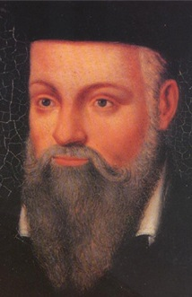
Cardano (1501-1576) – Impossible solution
A History of Numbers
Algebraic Numbers
Zero & Negatives
Complex Numbers
Pi
Golden Ratio
Binary & Bases
Primes & RSA
Two numbers that sum to give
10 and multiply to give 40
$5+\sqrt{−15}$ and $5−\sqrt{−15}$
“It is clear that this
case is impossible”

Slide 20
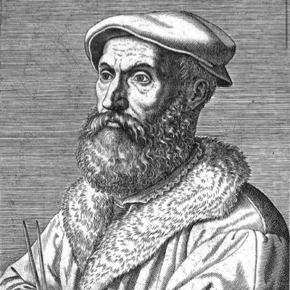
Bombelli (1526-1572)
A History of Numbers
Algebraic Numbers
Zero & Negatives
Complex Numbers
Pi
Golden Ratio
Binary & Bases
Primes & RSA
$$x=\sqrt[3]{\frac{q}{2}+\sqrt{\frac{q^{2}}{4}+\frac{p^{3}}{27}}}−\sqrt[3]{−\frac{q}{2}+\sqrt{\frac{q^{2}}{4}+\frac{p^{3}}{27}}}$$
$$x=a+b\sqrt{c}+a−b\sqrt{c}=2a$$

Slide 21
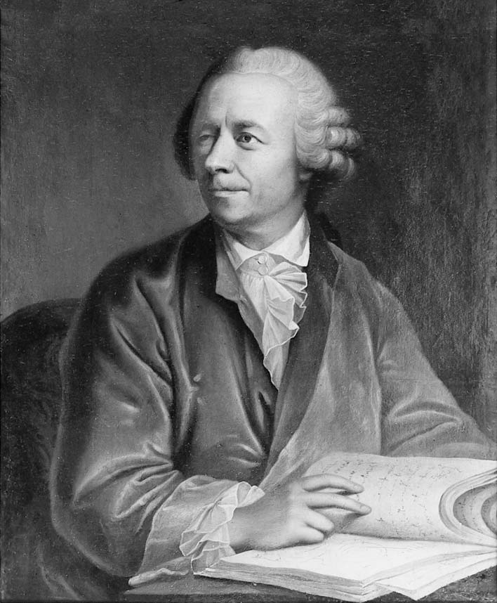
Euler (1707-1783) – Geometrical Representation
A History of Numbers
Algebraic Numbers
Zero & Negatives
Complex Numbers
Pi
Golden Ratio
Binary & Bases
Primes & RSA
$$\left.x+iy=r(\cos\left(θ\right)+isin\left(θ\right)\right)$$
$$\left.e^{iθ}=\cos\left(θ\right)+isin(θ\right)$$
$$e^{iπ}+1=0$$

Slide 22
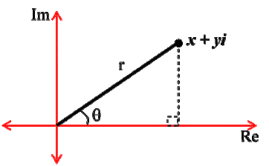
Argand (1768-1822) – The Argand Diagram
A History of Numbers
Algebraic Numbers
Zero & Negatives
Complex Numbers
Pi
Golden Ratio
Binary & Bases
Primes & RSA
Following on from Euler’ Work Argand was able to full geometrically represent complex numbers

Slide 23
Pi
H L

Slide 24
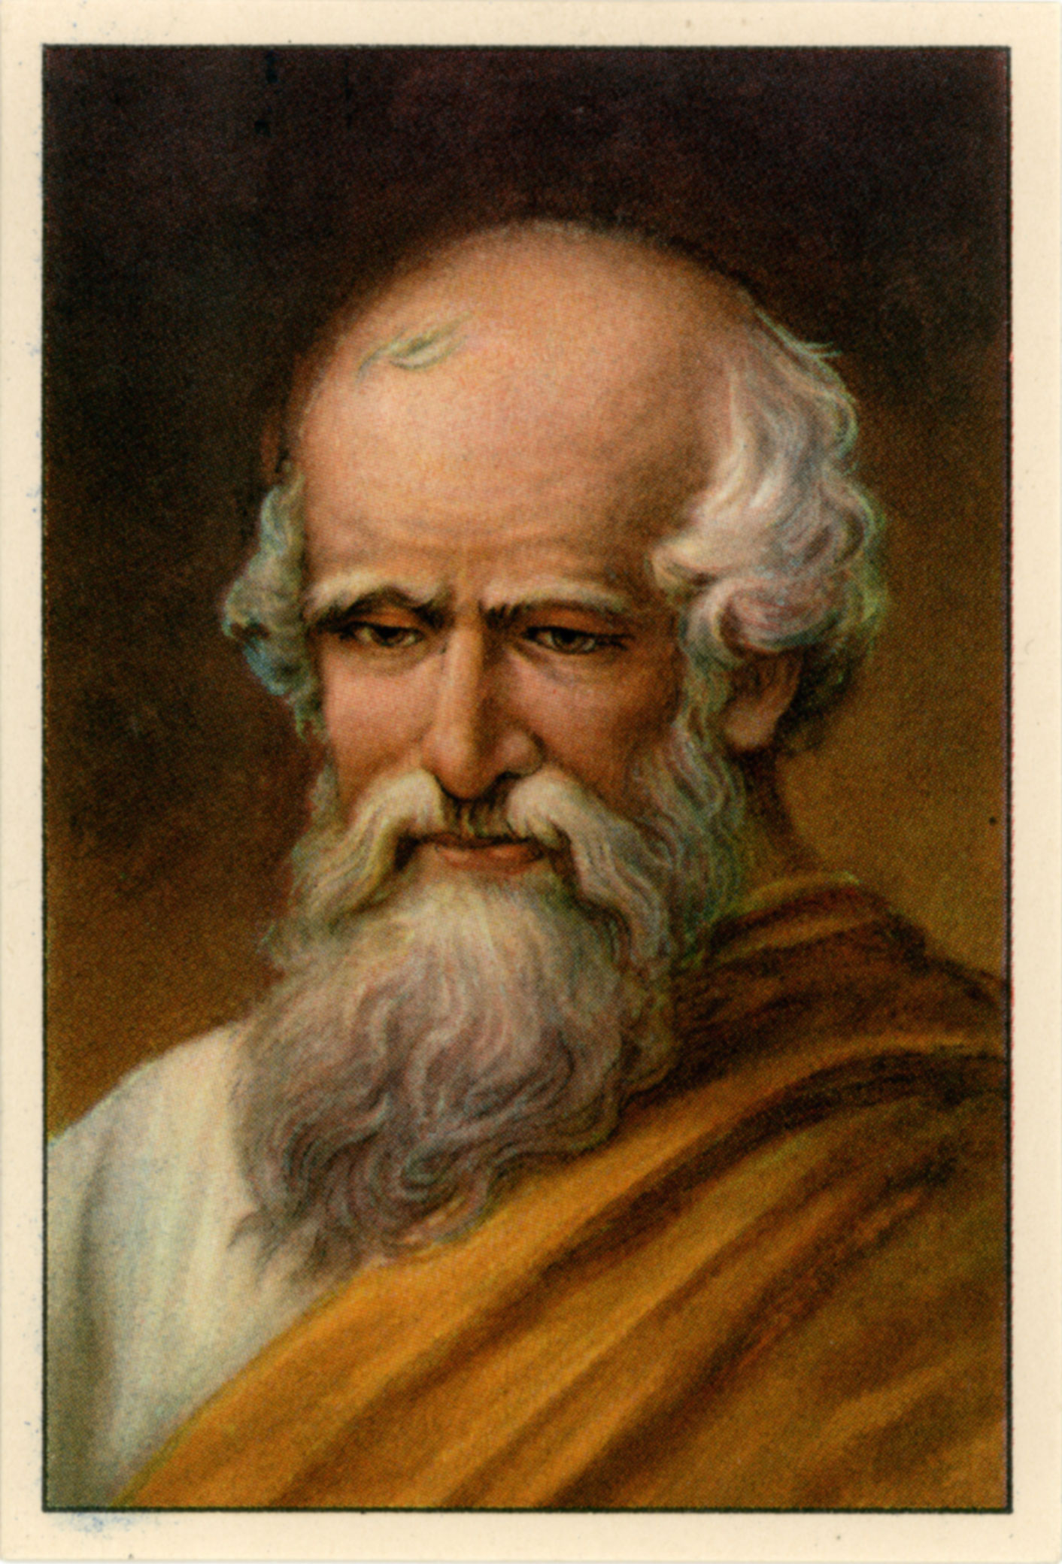
Approximations
A History of Numbers
Algebraic Numbers
Zero & Negatives
Complex Numbers
Pi
Golden Ratio
Binary & Bases
Primes & RSA
There have been a multitude of ways to approximate pi over the course of history.
Today, I am solely going to focus on the polygon approximation method - introduced by Archimedes of Syracruse around 290 BC.
The man, the myth.

Slide 25
What is it?
A History of Numbers
Algebraic Numbers
Zero & Negatives
Complex Numbers
Pi
Golden Ratio
Binary & Bases
Primes & RSA
The Polygon Approximation method uses – you guessed it – polygons, to estimate a value for pi.
It’s basic principle is that it calculates an upper bound and a lower bound of pi.
These bounds can be worked to any desired degree of accuracy.
All that’s needed is the formula for an area of a circle and a fair amount of paitence to work through the calculations.
$$π=\frac{A}{r^{2}}$$

Slide 26
How is it Done?
A History of Numbers
Algebraic Numbers
Zero & Negatives
Complex Numbers
Pi
Golden Ratio
Binary & Bases
Primes & RSA
Let’s say we were doing the polygon approximation method for a hexagon.
We would need a hexagon to inscribe a circle – this would be used as a lower bound.
We would also have a larger hexagon, circumscribing the circle, for a upper bound.

Slide 27
How is it Done?
A History of Numbers
Algebraic Numbers
Zero & Negatives
Complex Numbers
Pi
Golden Ratio
Binary & Bases
Primes & RSA
After calculating the areas for both hexagons, we would have an upper and lower bound for the area of a circle.
Assuming we have a circle with radius 3 units.
3

Slide 28
How is it Done?
A History of Numbers
Algebraic Numbers
Zero & Negatives
Complex Numbers
Pi
Golden Ratio
Binary & Bases
Primes & RSA
After calculating the areas for both hexagons, we would have an upper and lower bound for the area of a circle.
Assuming we have a circle with radius 3 units.
The area of the inner hexagon works out to be 23.38 units squared.
3

Slide 29
How is it Done?
A History of Numbers
Algebraic Numbers
Zero & Negatives
Complex Numbers
Pi
Golden Ratio
Binary & Bases
Primes & RSA
After calculating the areas for both hexagons, we would have an upper and lower bound for the area of a circle.
Assuming we have a circle with radius 3 units.
The area of the outer hexagon works out to be 31.18 units squared.
3

Slide 30
How is it Done?
A History of Numbers
Algebraic Numbers
Zero & Negatives
Complex Numbers
Pi
Golden Ratio
Binary & Bases
Primes & RSA
Using this formula with the areas, we work out the lower bound of pi to be 2.598, and an upper bound of 3.464
$2.598<π<3.464$
$$π=\frac{A}{r^{2}}$$
3

Slide 31
Polygon Approximations Over Time
A History of Numbers
Algebraic Numbers
Zero & Negatives
Complex Numbers
Pi
Golden Ratio
Binary & Bases
Primes & RSA
Archimedes used a 96 sided polygon to gain his own estimate.
$$3.14084< π <3.14285$$
This method remained the most accurate for many centuries, with great mathematicians simply going for the greatest amount of decimal places.

Slide 32
Polygon Approximations Over Time
A History of Numbers
Algebraic Numbers
Zero & Negatives
Complex Numbers
Pi
Golden Ratio
Binary & Bases
Primes & RSA
Archimedes used a 96 sided polygon to gain his own estimate.
$$3.14084< π <3.14285$$
This method remained the most accurate for many centuries, with great mathematicians simply going for the greatest amount of decimal places.
Liu Hui of the Wei Kingdom, 264 A.D.
Notes:
3072
12288

Slide 33
Polygon Approximations Over Time
A History of Numbers
Algebraic Numbers
Zero & Negatives
Complex Numbers
Pi
Golden Ratio
Binary & Bases
Primes & RSA
Archimedes used a 96 sided polygon to gain his own estimate.
$$3.14084< π <3.14285$$
This method remained the most accurate for many centuries, with great mathematicians simply going for the greatest amount of decimal places.
Liu Hui of the Wei Kingdom, 264 A.D.
Zu Chongzhi, Fifth Century.

Slide 34
The Transition to Infinite Series
A History of Numbers
Algebraic Numbers
Zero & Negatives
Complex Numbers
Pi
Golden Ratio
Binary & Bases
Primes & RSA
As the quest for more digits continued, the polygon approximation method began to phase out and was replaces with the use of infinite series to approximate pi.

Slide 35
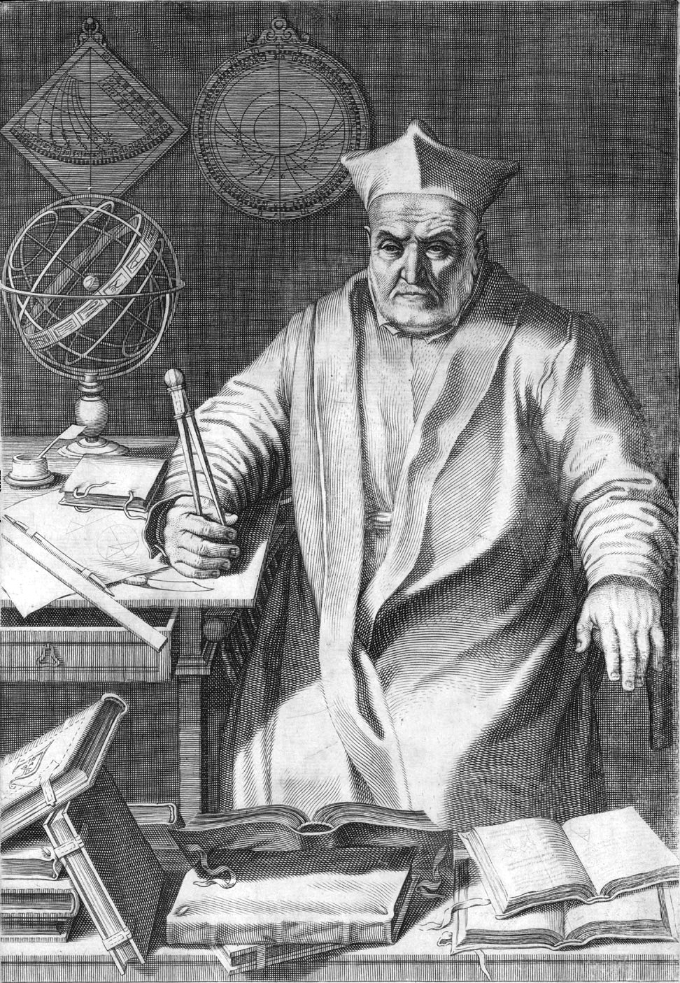
The Transition to Infinite Series
A History of Numbers
Algebraic Numbers
Zero & Negatives
Complex Numbers
Pi
Golden Ratio
Binary & Bases
Primes & RSA
As the quest for more digits continued, the polygon approximation method began to phase out and was replaces with the use of infinite series to approximate pi.
The final attempt done by hand was performed by Austrian astronomer Christoph Grienberger. Who managed an accuracy of 39 digits – which would’ve required a polygon of ${\text{10}}^{\text{40}}$.
I think this is him.

Slide 36
The Transition to Infinite Series
A History of Numbers
Algebraic Numbers
Zero & Negatives
Complex Numbers
Pi
Golden Ratio
Binary & Bases
Primes & RSA
Fast forward 2000 years from Archimedes getting a value of pi accurate to 2 decimal places and we have today, where we have mastered pi to 10 trillion places.

Slide 37
The Transition to Infinite Series
A History of Numbers
Algebraic Numbers
Zero & Negatives
Complex Numbers
Pi
Golden Ratio
Binary & Bases
Primes & RSA
Fast forward 2000 years from Archimedes getting a value of pi accurate to 2 decimal places and we have today, where we have mastered pi to 10 trillion places.
This all seems rather futile when considering that if we were to calculate the diameter of the entire known universe, to use a value of pi correct to 39 decimal digits would give an inaccuracy of degree so tiny, it would be less than the size of a hydrogen atom.

Slide 38
The Transition to Infinite Series
A History of Numbers
Algebraic Numbers
Zero & Negatives
Complex Numbers
Pi
Golden Ratio
Binary & Bases
Primes & RSA
Fast forward 2000 years from Archimedes getting a value of pi accurate to 2 decimal places and we have today, where we have mastered pi to 10 trillion places.
This all seems rather futile when considering that if we were to calculate the diameter of the entire known universe, to use a value of pi correct to 39 decimal digits would give an inaccuracy of degree so tiny, it would be less than the size of a hydrogen atom.
Yet we persist, using more complex algorithms and more powerful computers to not only calculate more digits – but work out a specific digit.

Slide 39
Golden Ratio
M H

Slide 40
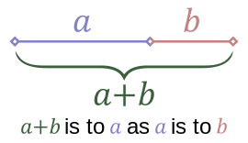
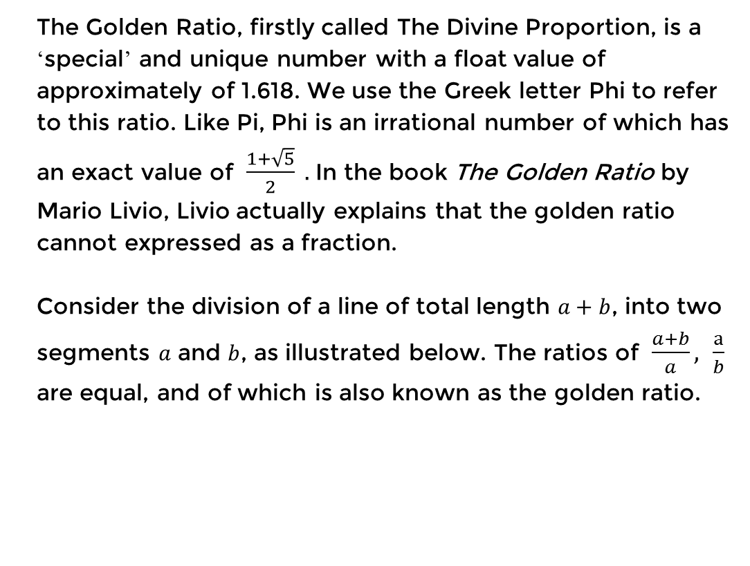
The Golden Ratio
A History of Numbers
Algebraic Numbers
Zero & Negatives
Complex Numbers
Pi
Golden Ratio
Binary & Bases
Primes & RSA
The Golden Ratio, firstly called The Divine Proportion, is a ‘special’ and unique number with a float value of approximately of 1.618. We use the Greek letter Phi to refer to this ratio. Like Pi, Phi is an irrational number of which has an exact value of $\frac{1+\sqrt{5}}{2} .$In the book The Golden Ratio by Mario Livio, Livio actually explains that the golden ratio cannot expressed as a fraction.
Consider the division of a line of total length $a+b$, into two segments $a$ and $b$, as illustrated below. The ratios of $\frac{a+b}{a}, \frac{a}{b}$ are equal, and of which is also known as the golden ratio.

Slide 41
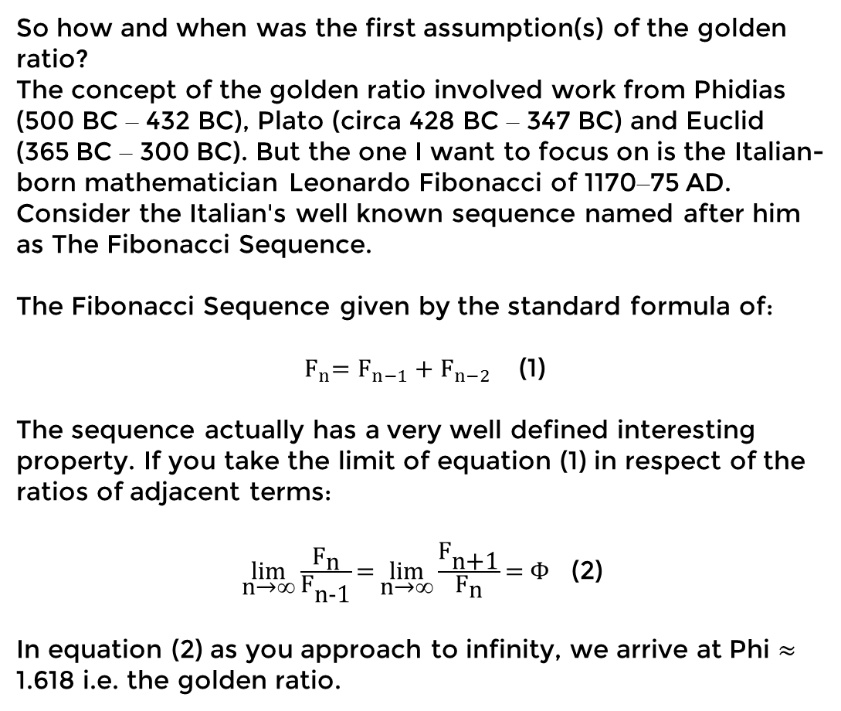
The Golden Ratio
A History of Numbers
Algebraic Numbers
Zero & Negatives
Complex Numbers
Pi
Golden Ratio
Binary & Bases
Primes & RSA
So how and when was the first assumption(s) of the golden ratio?
The concept of the golden ratio involved work from Phidias (500 BC – 432 BC), Plato (circa 428 BC – 347 BC) and Euclid (365 BC – 300 BC). But the one I want to focus on is the Italian-born mathematician Leonardo Fibonacci of 1170–75 AD. Consider the Italian's well known sequence named after him as The Fibonacci Sequence.
The Fibonacci Sequence given by the standard formula of:
${ F}_{n}=F_{n−1}+F_{n−2}$ (1)
The sequence actually has a very well defined interesting property. If you take the limit of equation (1) in respect of the ratios of adjacent terms:
$\underset{\text{n}\text{→}\text{∞}}{\text{lim}}{\frac{{\text{F}}_{\text{n}}}{{\text{F}}_{\text{n}\text{−1}}}\text{=}\underset{\text{n}\text{→}\text{∞}}{\text{lim}}{\frac{{\text{F}}_{\text{n}\text{+1}}}{{\text{F}}_{\text{n}}}\text{= }\text{Φ}}}$ (2)
In equation (2) as you approach to infinity, we arrive at Phi $≈$ 1.618 i.e. the golden ratio.

Slide 42
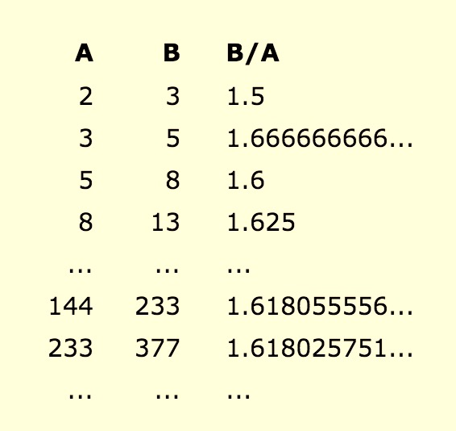
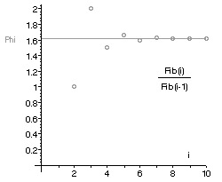
The Golden Ratio
A History of Numbers
Algebraic Numbers
Zero & Negatives
Complex Numbers
Pi
Golden Ratio
Binary & Bases
Primes & RSA
The previous equation (2) can visually interpreted by the below pair of figures.

Slide 43
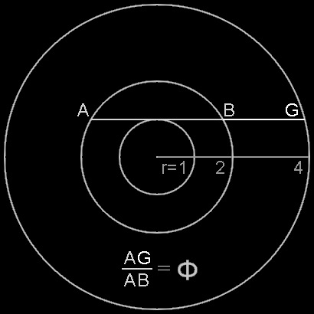
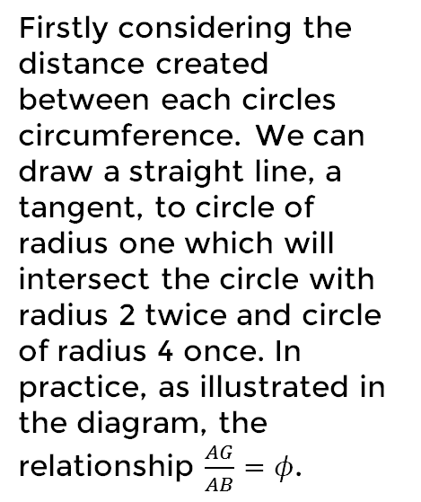
The Golden Ratio
A History of Numbers
Algebraic Numbers
Zero & Negatives
Complex Numbers
Pi
Golden Ratio
Binary & Bases
Primes & RSA
The Golden Ratio doesn't just exist in the abstract side of mathematics, it can also be shown in geometry as first constructed and developed by S. Kutler. Below is Kutler’s diagram of an array of concentric circles with whose centres are of the same with radiuses of ratio relationship of 1 : 2 : 4.
Firstly considering the distance created between each circles circumference. We can draw a straight line, a tangent, to circle of radius one which will intersect the circle with radius 2 twice and circle of radius 4 once. In practice, as illustrated in the diagram, the relationship $\frac{AG}{AB}=φ$.

Slide 44
The Golden Ratio’s Appearance
A History of Numbers
Algebraic Numbers
Zero & Negatives
Complex Numbers
Pi
Golden Ratio
Binary & Bases
Primes & RSA
Interestingly the golden ratio is believed and said to have guided many artists and architects over the centuries and had a big influence on their work. Many artists are said to have included in their work the golden ratio. This is in the purpose of achieving and creating aesthetically pleasing art work. This is with the use of the concept, introduced on the first slide, with the line example. This is also known as Golden Section. Many artists, many centuries ago are said to have included this in their work.

Slide 45
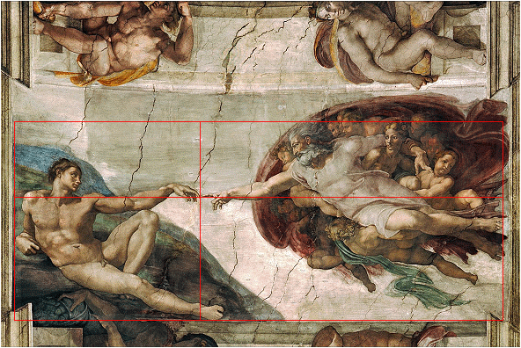
The Golden Ratio’s Appearance Cont'd.
A History of Numbers
Algebraic Numbers
Zero & Negatives
Complex Numbers
Pi
Golden Ratio
Binary & Bases
Primes & RSA
Taking into consideration the famous artist Michelangelo’s work, there is a certain piece of which you can see geometrically the golden section embedded. In his work The Creation of Adam of 1500-1520 it can be outlined as below. This is of course used to achieve a more aesthetical look.

Slide 46
Binary & Other Bases
P S

Slide 47
Binary and Other Bases
A History of Numbers
Algebraic Numbers
Zero & Negatives
Complex Numbers
Pi
Golden Ratio
Binary & Bases
Primes & RSA
What is a base?
It is essentially how you count and represent numbers. The name of a base is given by the amount of unique symbols it has, binary has 2: 0 and 1, and decimal has 10 from 0 to 9.

Slide 48
Binary and Other Bases
A History of Numbers
Algebraic Numbers
Zero & Negatives
Complex Numbers
Pi
Golden Ratio
Binary & Bases
Primes & RSA
Here are some examples of bases:
Binary
Hexadecimal
Decimal
Sexagesimal
Vigesimal
Duodecimal

Slide 49
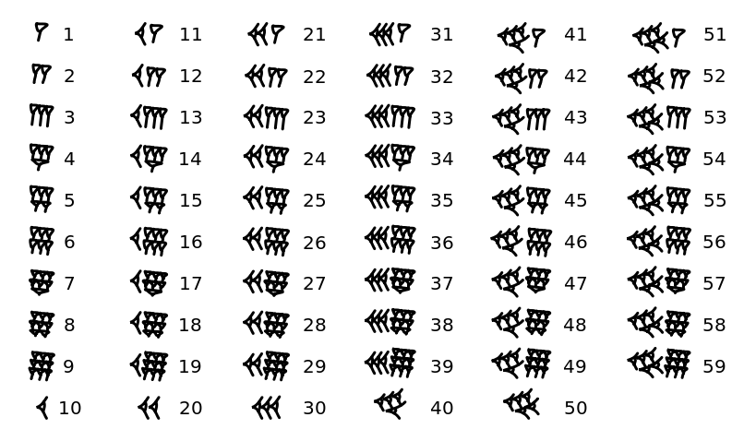
Binary and Other Bases
A History of Numbers
Algebraic Numbers
Zero & Negatives
Complex Numbers
Pi
Golden Ratio
Binary & Bases
Primes & RSA
Sexagesimal is thought to have originated with the Sumerians at around 3000 BC before being passed down to the Bablyonians.
The sexagesimal system only used two unique symbols one representing a value of 10 the other a value of 1.

Slide 50
Binary and Other Bases
A History of Numbers
Algebraic Numbers
Zero & Negatives
Complex Numbers
Pi
Golden Ratio
Binary & Bases
Primes & RSA
Sexigesimal still finds use today in measurements of time and measurements of angles.
There are 60 seconds in a minute and there are 60 minutes in an hour, but also there are 60 minutes in a degree with 60 seconds to that minute.
The length of day for the Babylonians was equal to ours, however it had different divisions. They had 12 hours to a day and 30 minutes to an hour.
This division is also found in the length of their year which had 360 days divided into 12 equal months. This division of the day is also the reasoning behind the division of the circle into 360 degrees.

Slide 51
Primes & RSA
J S

Slide 52
Definiton of a Prime Number
A History of Numbers
Algebraic Numbers
Zero & Negatives
Complex Numbers
Pi
Golden Ratio
Binary & Bases
Primes & RSA
“A Prime number is a number which is measured by unit alone” - Euclid
A number which can only be uniquely divided by 1 and itself.
17/1 = 17 1/1=1
17/17 = 1 1/1=1

Slide 53
Sieve of Eratoshenes
A History of Numbers
Algebraic Numbers
Zero & Negatives
Complex Numbers
Pi
Golden Ratio
Binary & Bases
Primes & RSA
1 | 2 | 3 | 4 | 5 | 6 | 7 | 8 | 9 | 10
11 | 12 | 13 | 14 | 15 | 16 | 17 | 18 | 19 | 20
21 | 22 | 23 | 24 | 25 | 26 | 27 | 28 | 29 | 30
31 | 32 | 33 | 34 | 35 | 36 | 37 | 38 | 39 | 40
41 | 42 | 43 | 44 | 45 | 46 | 47 | 48 | 49 | 50
51 | 52 | 53 | 54 | 55 | 56 | 57 | 585 | 59 | 60
61 | 62 | 63 | 64 | 65 | 66 | 67 | 68 | 69 | 70
71 | 72 | 73 | 74 | 75 | 76 | 77 | 78 | 79 | 80
81 | 82 | 83 | 84 | 85 | 86 | 87 | 88 | 89 | 90
91 | 92 | 93 | 94 | 95 | 96 | 97 | 98 | 99 | 100

Slide 54
Sieve of Eratoshenes
A History of Numbers
Algebraic Numbers
Zero & Negatives
Complex Numbers
Pi
Golden Ratio
Binary & Bases
Primes & RSA
 | 2 | 3 | 4 | 5 | 6 | 7 | 8 | 9 | 10
11 | 12 | 13 | 14 | 15 | 16 | 17 | 18 | 19 | 20
21 | 22 | 23 | 24 | 25 | 26 | 27 | 28 | 29 | 30
31 | 32 | 33 | 34 | 35 | 36 | 37 | 38 | 39 | 40
41 | 42 | 43 | 44 | 45 | 46 | 47 | 48 | 49 | 50
51 | 52 | 53 | 54 | 55 | 56 | 57 | 58 | 59 | 60
61 | 62 | 63 | 64 | 65 | 66 | 67 | 68 | 69 | 70
71 | 72 | 73 | 74 | 75 | 76 | 77 | 78 | 79 | 80
81 | 82 | 83 | 84 | 85 | 86 | 87 | 88 | 89 | 90
91 | 92 | 93 | 94 | 95 | 96 | 97 | 98 | 99 | 100

Slide 55
Sieve of Eratoshenes
A History of Numbers
Algebraic Numbers
Zero & Negatives
Complex Numbers
Pi
Golden Ratio
Binary & Bases
Primes & RSA
 | 2 | 3 | 4 | 5 | 6 | 7 | 8 | 9 | 10
11 | 12 | 13 | 14 | 15 | 16 | 17 | 18 | 19 | 20
21 | 22 | 23 | 24 | 25 | 26 | 27 | 28 | 29 | 30
31 | 32 | 33 | 34 | 35 | 36 | 37 | 38 | 39 | 40
41 | 42 | 43 | 44 | 45 | 46 | 47 | 48 | 49 | 50
51 | 52 | 53 | 54 | 55 | 56 | 57 | 58 | 59 | 60
61 | 62 | 63 | 64 | 65 | 66 | 67 | 68 | 69 | 70
71 | 72 | 73 | 74 | 75 | 76 | 77 | 78 | 79 | 80
81 | 82 | 83 | 84 | 85 | 86 | 87 | 88 | 89 | 90
91 | 92 | 93 | 94 | 95 | 96 | 97 | 98 | 99 | 100

Slide 56
Sieve of Eratoshenes
A History of Numbers
Algebraic Numbers
Zero & Negatives
Complex Numbers
Pi
Golden Ratio
Binary & Bases
Primes & RSA
 | 2 | 3 | 4 | 5 | 6 | 7 | 8 | 9 | 10
11 | 12 | 13 | 14 | 15 | 16 | 17 | 18 | 19 | 20
21 | 22 | 23 | 24 | 25 | 26 | 27 | 28 | 29 | 30
31 | 32 | 33 | 34 | 35 | 36 | 37 | 38 | 39 | 40
41 | 42 | 43 | 44 | 45 | 46 | 47 | 48 | 49 | 50
51 | 52 | 53 | 54 | 55 | 56 | 57 | 58 | 59 | 60
61 | 62 | 63 | 64 | 65 | 66 | 67 | 68 | 69 | 70
71 | 72 | 73 | 74 | 75 | 76 | 77 | 78 | 79 | 80
81 | 82 | 83 | 84 | 85 | 86 | 87 | 88 | 89 | 90
91 | 92 | 93 | 94 | 95 | 96 | 97 | 98 | 99 | 100

Slide 57
Sieve of Eratoshenes
A History of Numbers
Algebraic Numbers
Zero & Negatives
Complex Numbers
Pi
Golden Ratio
Binary & Bases
Primes & RSA
 | 2 | 3 | 4 | 5 | 6 | 7 | 8 | 9 | 10
11 | 12 | 13 | 14 | 15 | 16 | 17 | 18 | 19 | 20
21 | 22 | 23 | 24 | 25 | 26 | 27 | 28 | 29 | 30
31 | 32 | 33 | 34 | 35 | 36 | 37 | 38 | 39 | 40
41 | 42 | 43 | 44 | 45 | 46 | 47 | 48 | 49 | 50
51 | 52 | 53 | 54 | 55 | 56 | 57 | 58 | 59 | 60
61 | 62 | 63 | 64 | 65 | 66 | 67 | 68 | 69 | 70
71 | 72 | 73 | 74 | 75 | 76 | 77 | 78 | 79 | 80
81 | 82 | 83 | 84 | 85 | 86 | 87 | 88 | 89 | 90
91 | 92 | 93 | 94 | 95 | 96 | 97 | 98 | 99 | 100

Slide 58
Sieve of Eratoshenes
A History of Numbers
Algebraic Numbers
Zero & Negatives
Complex Numbers
Pi
Golden Ratio
Binary & Bases
Primes & RSA
 | 2 | 3 | 4 | 5 | 6 | 7 | 8 | 9 | 10
11 | 12 | 13 | 14 | 15 | 16 | 17 | 18 | 19 | 20
21 | 22 | 23 | 24 | 25 | 26 | 27 | 28 | 29 | 30
31 | 32 | 33 | 34 | 35 | 36 | 37 | 38 | 39 | 40
41 | 42 | 43 | 44 | 45 | 46 | 47 | 48 | 49 | 50
51 | 52 | 53 | 54 | 55 | 56 | 57 | 58 | 59 | 60
61 | 62 | 63 | 64 | 65 | 66 | 67 | 68 | 69 | 70
71 | 72 | 73 | 74 | 75 | 76 | 77 | 78 | 79 | 80
81 | 82 | 83 | 84 | 85 | 86 | 87 | 88 | 89 | 90
91 | 92 | 93 | 94 | 95 | 96 | 97 | 98 | 99 | 100

Slide 59
Sieve of Eratoshenes
A History of Numbers
Algebraic Numbers
Zero & Negatives
Complex Numbers
Pi
Golden Ratio
Binary & Bases
Primes & RSA
 | 2 | 3 | 4 | 5 | 6 | 7 | 8 | 9 | 10
11 | 12 | 13 | 14 | 15 | 16 | 17 | 18 | 19 | 20
21 | 22 | 23 | 24 | 25 | 26 | 27 | 28 | 29 | 30
31 | 32 | 33 | 34 | 35 | 36 | 37 | 38 | 39 | 40
41 | 42 | 43 | 44 | 45 | 46 | 47 | 48 | 49 | 50
51 | 52 | 53 | 54 | 55 | 56 | 57 | 58 | 59 | 60
61 | 62 | 63 | 64 | 65 | 66 | 67 | 68 | 69 | 70
71 | 72 | 73 | 74 | 75 | 76 | 77 | 78 | 79 | 80
81 | 82 | 83 | 84 | 85 | 86 | 87 | 88 | 89 | 90
91 | 92 | 93 | 94 | 95 | 96 | 97 | 98 | 99 | 100

Slide 60
RSA
A History of Numbers
Algebraic Numbers
Zero & Negatives
Complex Numbers
Pi
Golden Ratio
Binary & Bases
Primes & RSA
RSA (Rivest, Shamir and Adleman 1978)
Choose two prime numbers $P_{1}{ and P}_{2}$
Define a number N as the product of $P_{1}$ and $P_{2}$ $N=P_{1}∗P_{2}$
Define $φN={(P}_{1}−1)∗{(P}_{2}−1)$
Choose a random integer between 1 and $φN$.
Solve for d given that $d∗e=1 mod φN$

